Slide 1
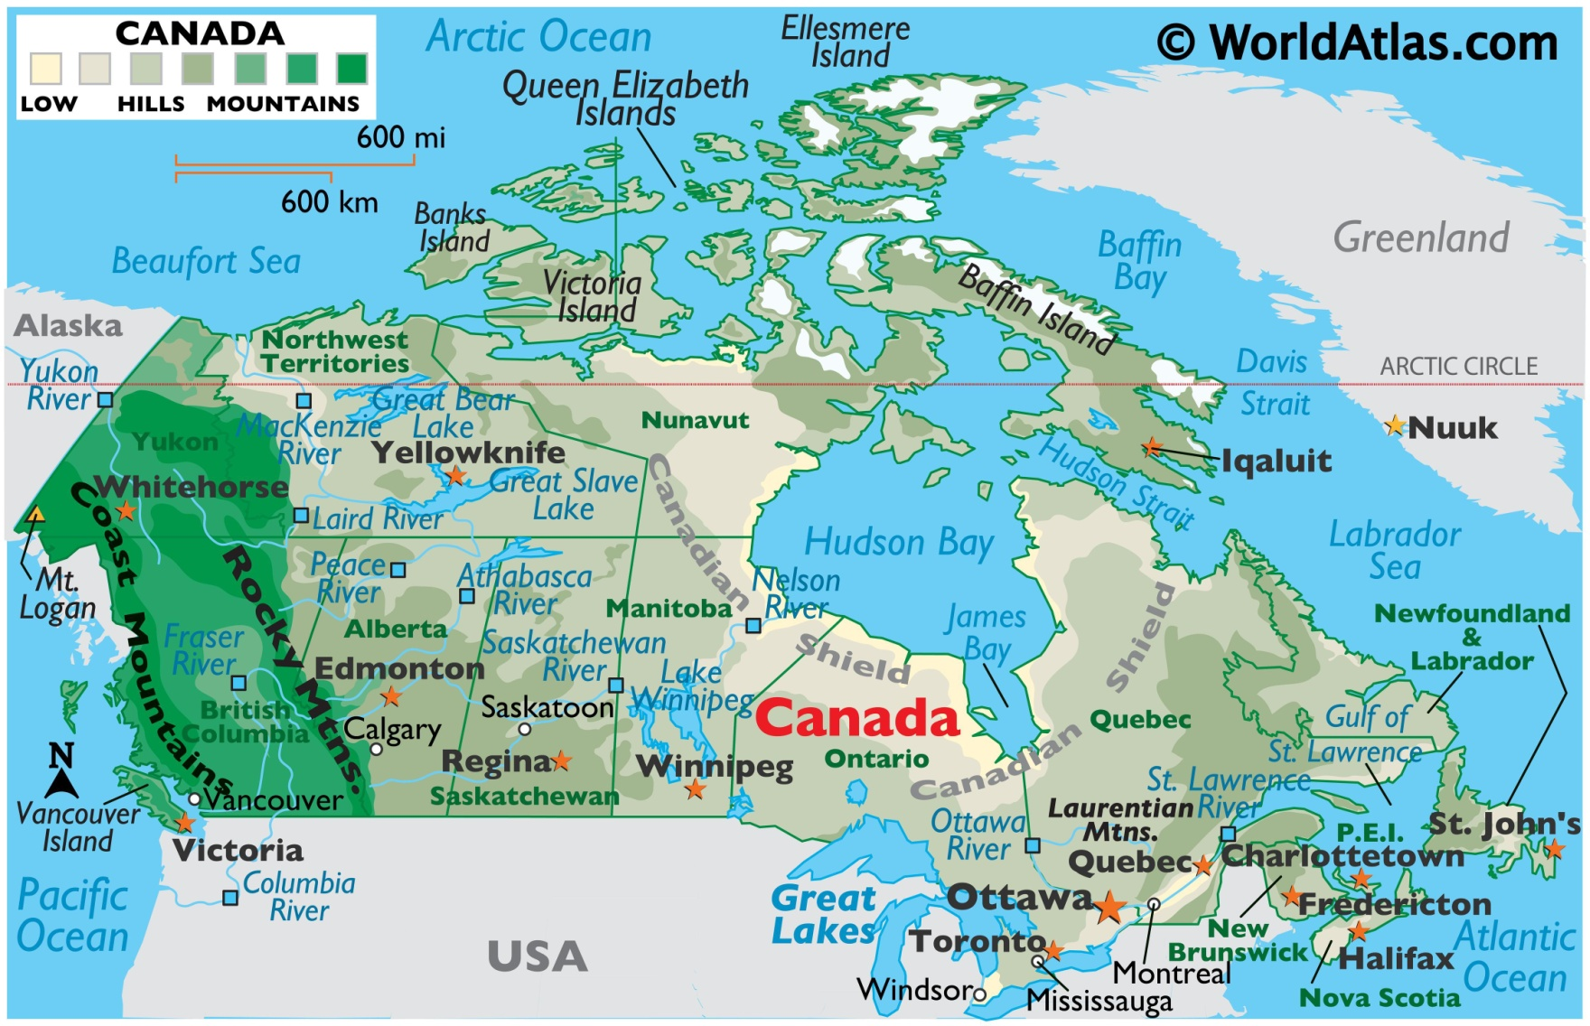

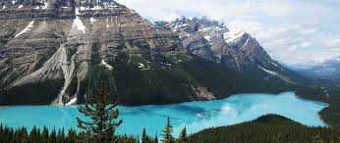
Canada
March 27-31

Slide 2
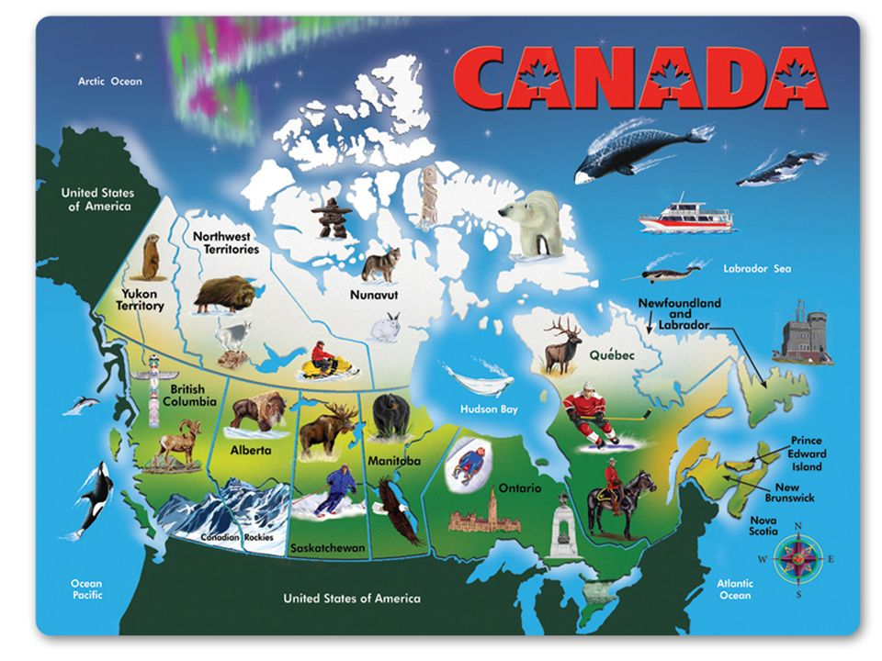

Slide 3
SS6G4 Locate selected features of Canada.
Locate on a world and regional political-physical map: the St. Lawrence River, Hudson Bay, Atlantic Ocean, Pacific Ocean, the Great Lakes, Canadian Shield, and Rocky Mountains.
b. Locate on a world and regional political-physical map Canada and the province of Quebec.
SS6G5 Explain the impact of location, climate, distribution of natural resources, and population distribution on Canada.
a. Describe how Canada’s location, climate, and natural resources impact trade and affect where people live.
SS6G6 Explain the impact of environmental issues in Canada.
a. Explain the causes and effects of pollution and acid rain in Canada to include the Great Lakes.
b. Explain the causes and effects of the extraction of natural resources on the Canadian Shield (e.g., mining and logging).

Slide 4
SS6H2 Describe Quebec’s independence movement.
SS6CG2 Explain citizen participation in the Canadian government. a. Explain the role of citizens in choosing the leader of Canada (parliamentary democracy)

Slide 5
 | Monday 27 | Tuesday 28 | Wednesday 29 | Thursday 30 | Friday 31
Focus Standard(s) | SS6H2 | SS6H2 | SS6H2 | SS6H2
Learning Target(s) | Canada History, Quebec’s Independence, Language/Religion | Canada History, Quebec’s Independence, Language/Religion | Canada History, Quebec’s Independence, Language/Religion | Canada History, Quebec’s Independence, Language/Religion | GRIT DAY
Opening | Canada Map Trace | Canada Map Trace and Make Answer Key | EdPuzzle- Canada | EdPuzzle- Canada
Work Session | Textbook Chapter 10 Pages 244-250 | Textbook Chapter 10 Pages 244-250 | Textbook Chapter 10 Pages 244-250 Missing Assignments | Textbook Chapter 10 Pages 244-250 Missing Assignments
Closing | TOD | Think-Pair-Share | Class Discussion | Think-Pair-Share
Minor Assignments Due |  |  | Quiz
Major Assignments Due
Current Relearning & Reassessment Assignments (with due dates) |  | Continue to have students study and complete any missing graded assignments
Vocabulary
Upcoming Major Assignments

Slide 6
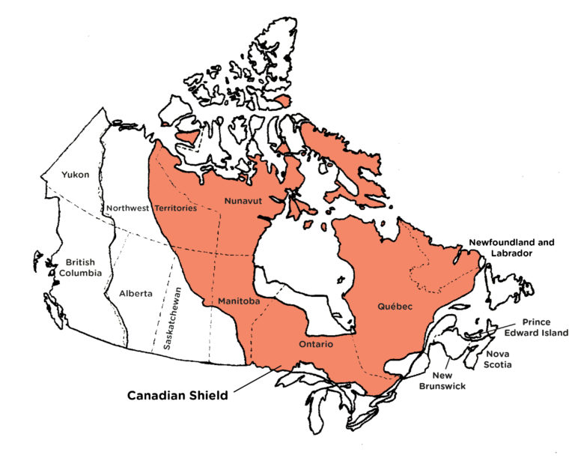
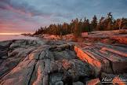

The Canadian Shield
Video: Canadian Shield
Various minerals and precious stones have been mined or continue to be mined on the Shield, including gold, silver, copper, zinc, nickel, iron, uranium and diamonds. The first modern hard-rock mine in the Canadian Shield, near Madoc, Ontario, opened in 1866 after gold was found there.

Slide 7


Slide 8
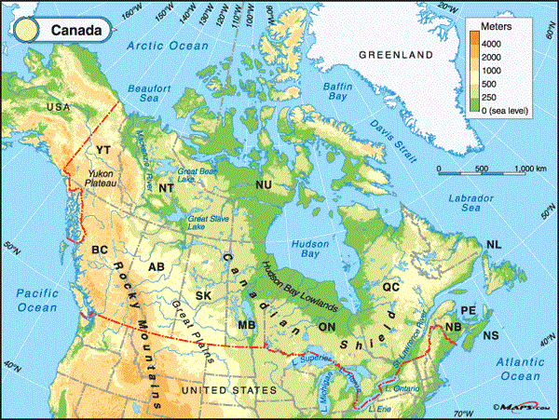
Locate on a world and regional political-physical map: the St. Lawrence River, Hudson Bay, Atlantic Ocean, Pacific Ocean, the Great Lakes, Canadian Shield, and Rocky Mountains.

Slide 9
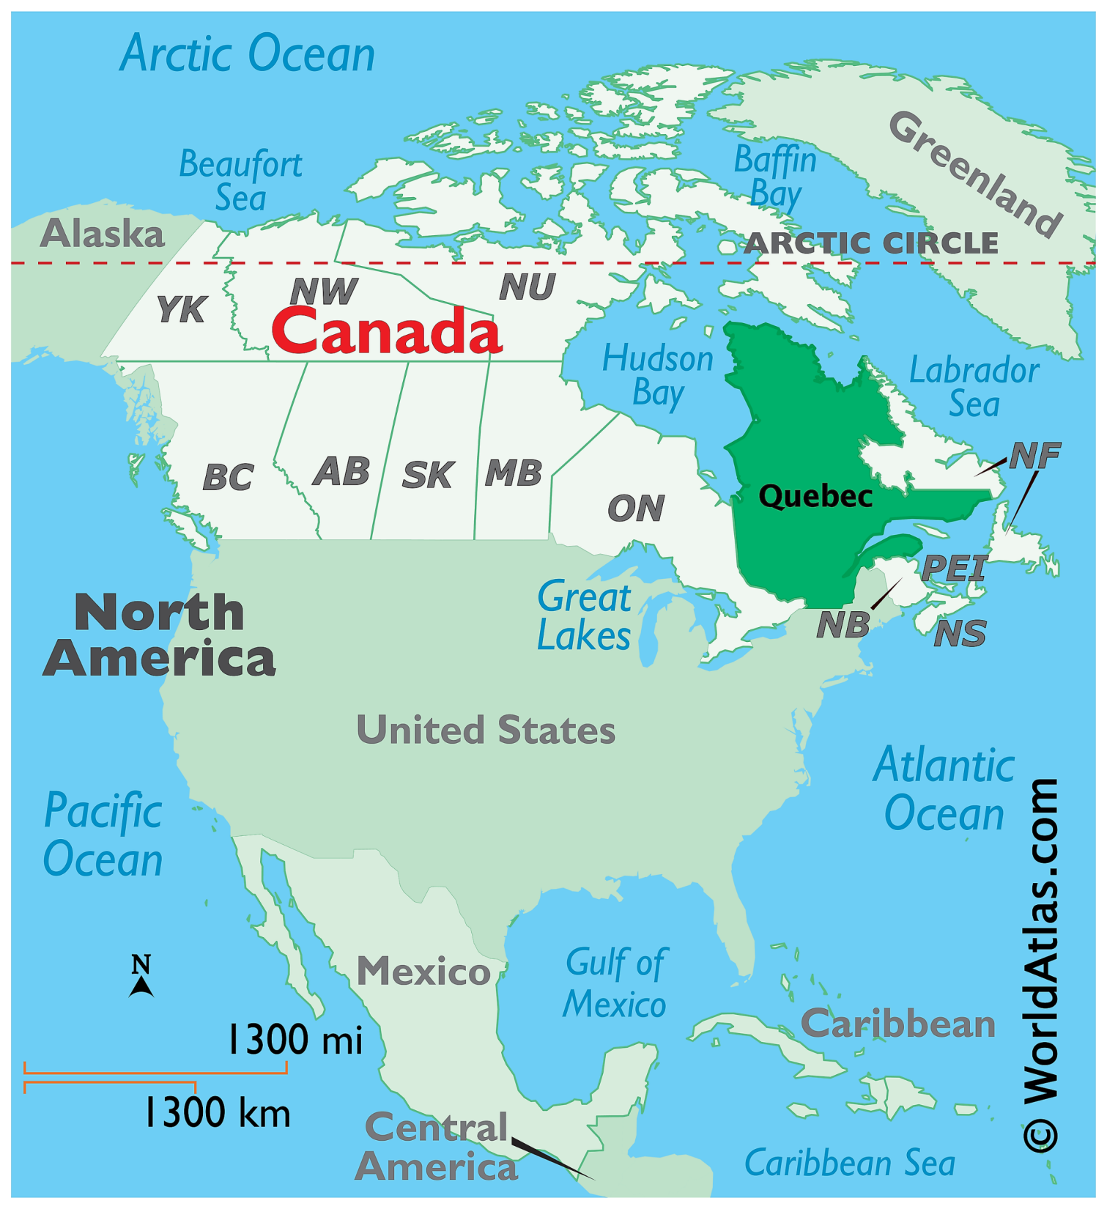
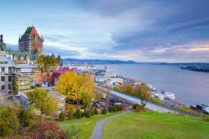
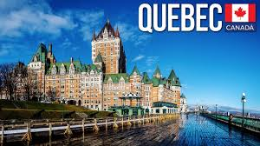

Slide 10
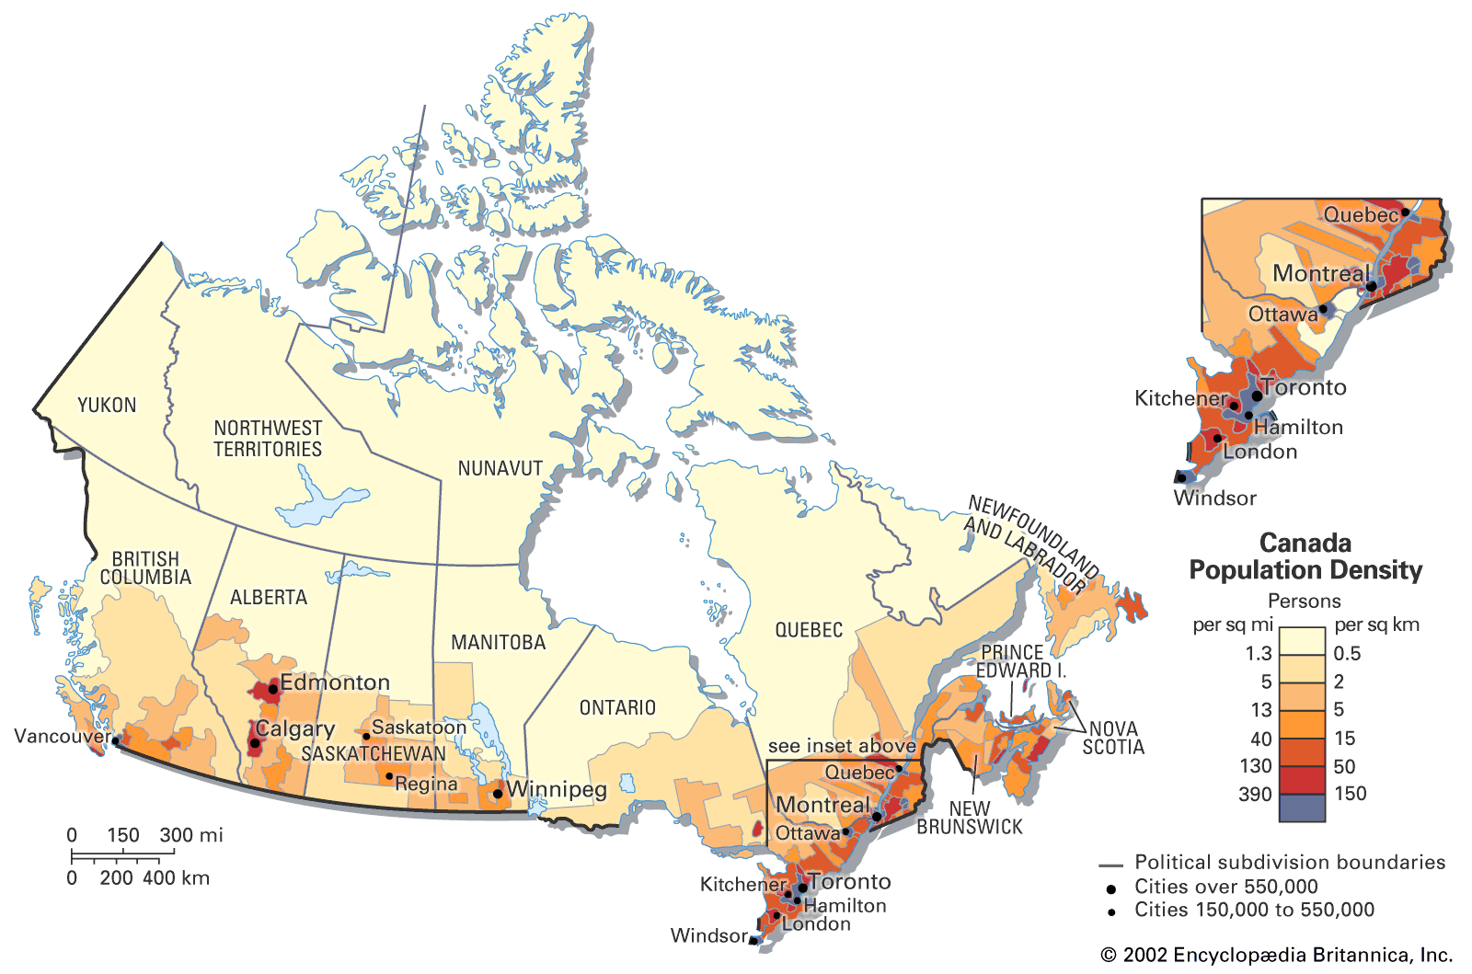
Population:
Where people located

Slide 11
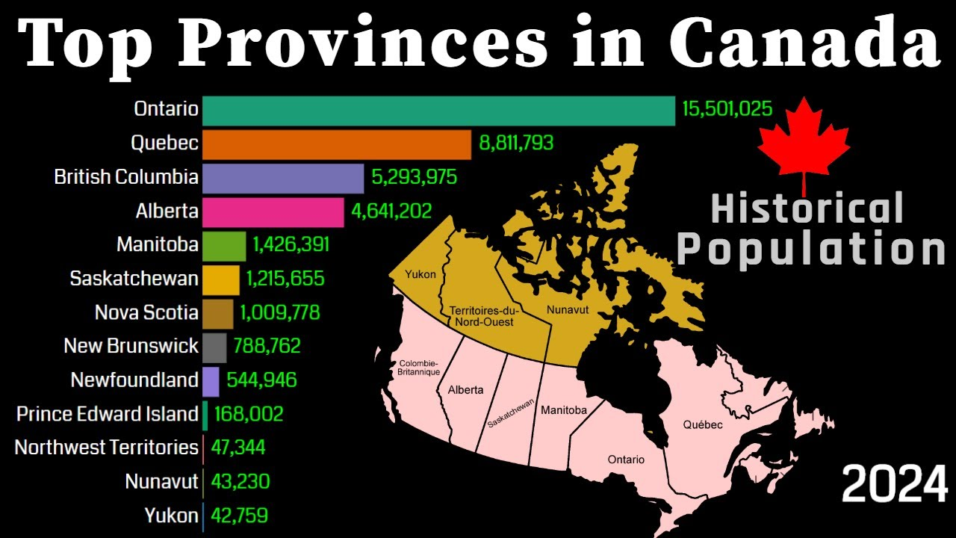

Slide 12
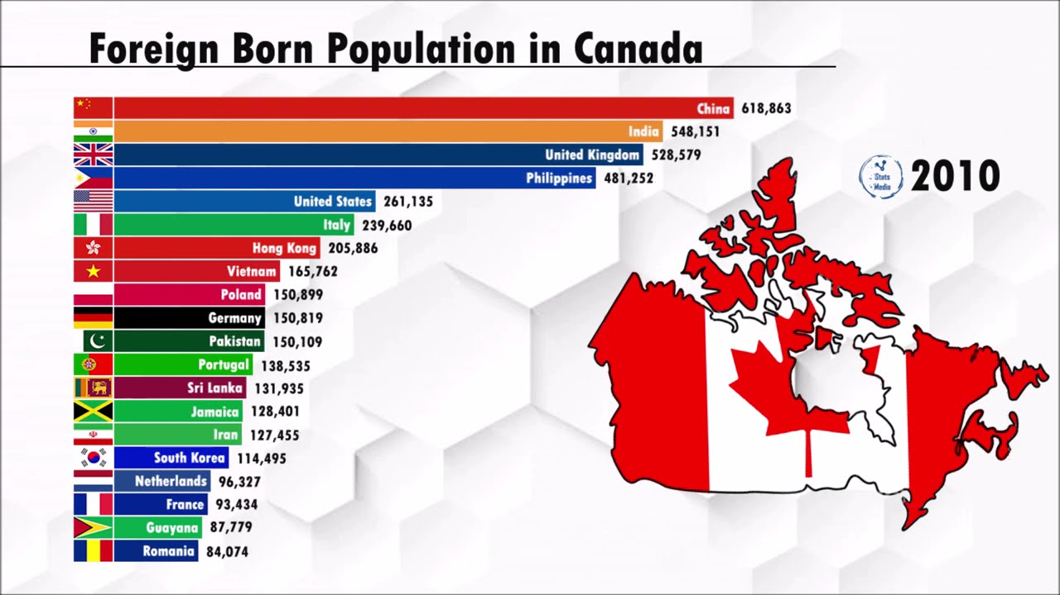

Slide 13
